Slide 1
Build iOS Apps with the Microsoft Graph
Implement Azure AD authentication to iOS applications

Slide 2

Building Microsoft Graph applications
Authentication overview
Azure AD
App Registration portal
Implementing MSAL in iOS apps

Slide 3
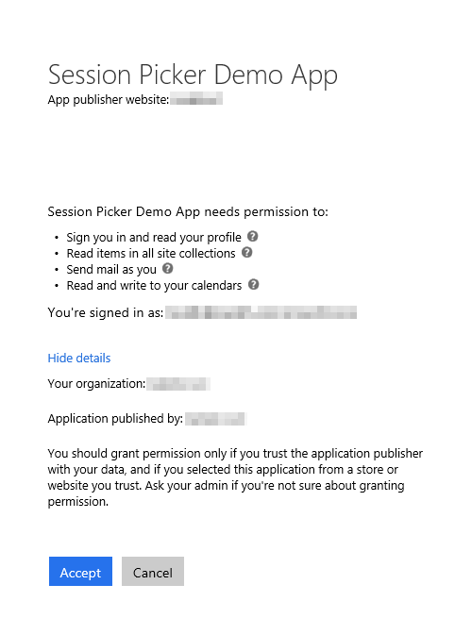
Azure AD OAuth in Office 365
Single authentication flow
Across all Office 365 services
“Native” apps and web sites
Admin and end-user consent
Secure protocol
OAuth 2.0 (no capturing user credentials)
Fine-grained access scopes
Supports MFA and federated user sign-in
Long-term access through refresh tokens
Unique considerations of “Native” Azure Apps
Inherently multi-tenant
No client/app secret (think about distribution)
Leverage a web authentication window/broker
Notes:
The Microsoft Graph leverages Azure AD, like so many other cloud services from Microsoft, for authentication and authorization
You can create web apps as well as native apps with Azure AD apps
In addition, users can authorize the application using delegated consent (where they grant the application to act on their behalf)
Global tenant admins can also grant consent to all users as a different type of consent (Admin Consent)
Azure AD app authentication implemented using OAuth 2.0 protocol
Users are redirected to Azure for authentication so custom applications never get the credentials
Depending on the authentication flow leveraged, the app ultimately gets an access token that’s only valid for a set amount of time, for a specific user, with specific permissions and for a specific resource (ie: Microsoft Graph)
These access tokens can be refreshed after expiration using an associated refresh token
This login process also supports MFA & federated authentication
Native applications differ from web applications in a few ways:
They are multi-tenant by default
You don’t need to worry about app secrets as when the native app is distributed, it can’t contain a secret … because it’s no longer a secret
Instead you use special redirect URIs

Slide 4



OAuth basics
OAuth client (native or web app)
Resource Server (REST API)
Access data
Bearer token
Access service
Delegate AuthN/AuthZ
Issue token
Grant access
Resource owner (end user)
Authorization server
Notes:
Every scenario has these basic parts. There are various implementations, but the premise is the same for all.
Both the client and the resource server need to know about the authorization server, in this case Azure AD.

Slide 5

Endpoint versions
v1
Microsoft account
Azure Active Directory v2.0 endpoint
Converged authentication accepts sign in from both Microsoft personal accounts and Azure AD work and school accounts.
Enables the same code for using Microsoft Graph for things like reading mail or retrieving contacts.
Dynamic consent, requesting permissions when you need them.
Additional Microsoft Graph capabilities for AAD users such as SharePoint and Microsoft Teams.
Azure Active Directory v1 endpoint
Enables access to Azure protected resources
v2
v1
Azure Active Directory
http://aka.ms/aadv2
AD
AD
AD
Notes:
The v2 endpoint includes breaking changes to protocols.
This is why it is the V2 endpoint. Because the protocol is different, requires new client library implementations.

Slide 6
Key improvements v2.0 versus v1
scope instead of resource parameter for interop
v1: resource=https://graph.microsoft.com
v2: scope=https://graph.microsoft.com/User.Read or scope=User.Read
Dynamic instead of static consent for incremental consent
id_token claims updated to OpenID Connect standard
Single app registration to represent native and web application combination
Well-known OpenID scopes
offline_access – Enables retrieving refresh tokens
openid – Allows your app to sign the user in and receive an app-specific identifier for the user
email – Allows your app access to the user’s primary email address via the email claim in the token
profile – Allows your app access to all other basic information such as name, preferred username, object ID, and others.
https://docs.microsoft.com/en-us/azure/active-directory/develop/active-directory-v2-compare
Notes:
In v1 endpoint, had to provide resource parameter to identify which resource you were requesting an access token for. Open source libraries were not able to easily incorporate into requests. Now use the scope parameter, which is supported by all libraries, to compound the resource and permission.
When you build applications with AADv1, had to register what permissions the application needed, and user consented to all permissions statically. With AADv2, can now send scopes you want at the time you want them, don’t need to ask for all of it up front.
Changed contents of id_token to better conform to Open ID Connect 1.0 specification, such as using preferredUserName claim instead of UPN claim. The most
In the past, if you needed a client app, single page app, web app, and web API, you had to create multiple registrations and wire up the relationships between them. AAD v2 now enables one registration across a single logical application.
For more information: https://docs.microsoft.com/en-us/azure/active-directory/develop/active-directory-v2-compare

Slide 7
SDKs
Microsoft Authentication Library (MSAL)
Targets v2.0 endpoint
New conceptual model
PublicClientApplication
ConfidentialClientApplication
Multiple platforms
MSAL.NET - .NET Client, Windows Store, UWP, Xamarin, iOS, and Android
MSAL.js – JavaScript
MSAL for ObjectiveC – iOS and macOS
MSAL for Android – Android
Azure Active Directory Authentication Library (ADAL)
Targets v1 endpoint
Notes:
As there are changes in the protocols between v1 and v2, this requires a change in the SDK and a new conceptual model.
PublicClientApplication uses the registered application ID. ConfidentialClientApplication has a secret (clientSecret or x.509 certificate).
MSAL is considered the successor to ADAL. This course focuses on MSAL and the AAD v2 endpoint with Microsoft Graph.

Slide 8
Azure AD Portal vs. App Registration Portal
Azure AD Portal
https://portal.azure.com
Login using Microsoft Account (MSA) / Azure AD account (work or school)
Create Azure AD apps that use the v1 authorization endpoint
Use Azure AD’s ADAL SDK for authentication
App Registration Portal
https://apps.dev.microsoft.com
Login using Microsoft Account (MSA) / Azure AD account (work or school)
Create Azure AD apps that use the v2 authorization endpoint
Use Azure AD’s MSAL SDK for authentication
Notes:
Azure AD has two different options for registering applications.
The Azure AD Portal is used for apps that are leveraging the v1 authentication endpoint while the App Registration Portal is used for the v2 authentication endpoint.
You must first decide which endpoint you plan to use for your application which will direct you to the correct portal.

Slide 9
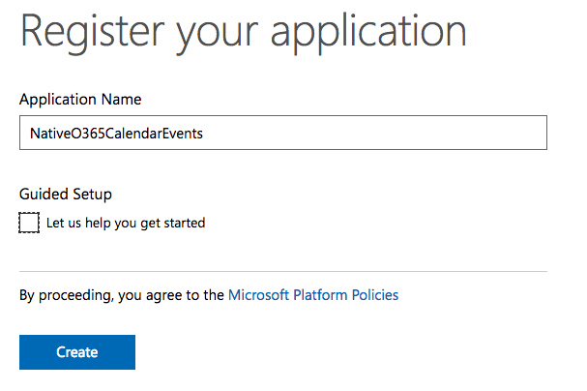
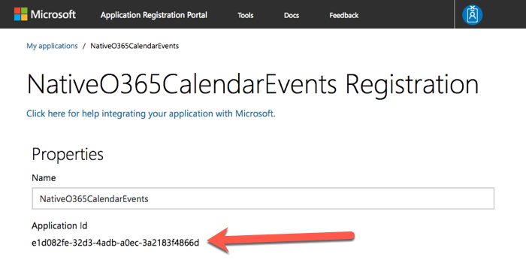
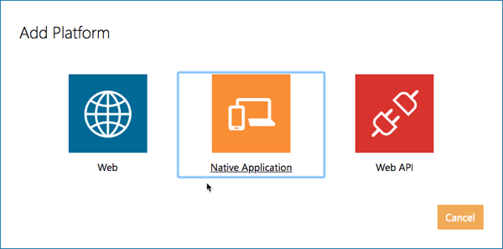
App Registration Portal (ARP)
Create the application using the ARP site
Copy the application’s ID
Add a native application platform to the app
Notes:
For Microsoft Graph apps, it’s recommended to use the Azure AD v2 authorization endpoint
Therefore you will use the App Registration portal site
Create the application
Copy the Application ID
Add a new Native application and add the necessary permissions

Slide 10
Implementing Azure AD Authentication for iOS apps

Slide 11
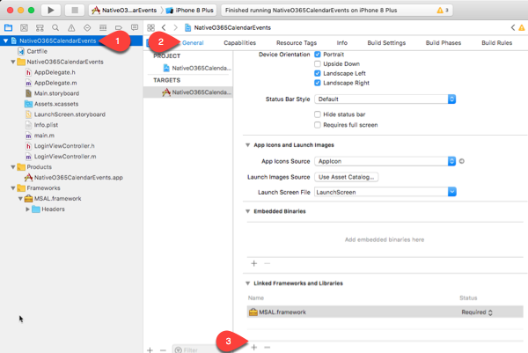
Add Azure AD’s MSAL iOS SDK to the App
Azure AD provides an iOS implementation of the Microsoft Authentication Library (MSAL)
Add to the project using Carthage (build and package manager)
MSAL handles integration with iOS to use the default browser to display the Azure AD login & delegated consent experience
MSAL & Microsoft Graph iOS SDK are not
Compatible
*if using MSAL, leverage the Microsoft Graph REST API
Notes:
The Azure AD team provides an iOS SDK for native iOS applications
Add this to your project using Carthage
Carthage is a build & package management tool commonly used in iOS development
Similar to MSBuild + NuGet in a .NET project

Slide 12
Demo

Slide 13
Thank you.

